Slide 1
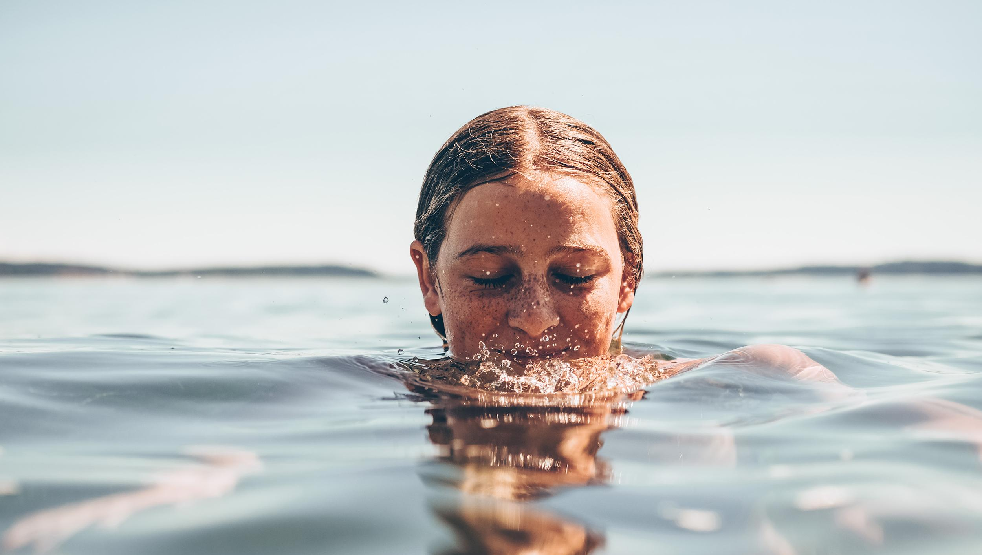
False Creek Residents Association
February 18

Slide 2
We use law, citizen engagement,
research and digital tools to ensure a swimmable, drinkable and fishable future in BC.

Slide 3
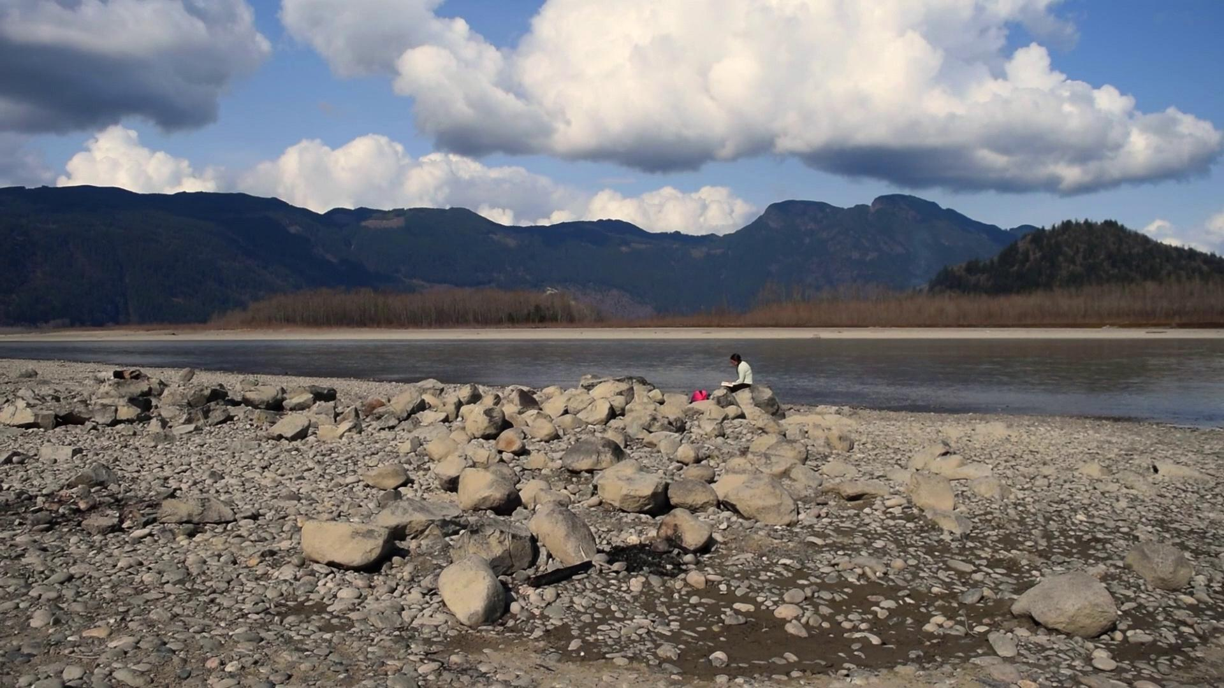
Notes:
We are Fraser Riverkeeper

Slide 4
Sadie Caron
Program Manager, Swim Drink Fish
Kate Moore
Vancouver Water Monitoring Coordinator, Swim Drink Fish
Notes:
Sadie
My name is Sadie Caron and I’m the Program Manager for Swim Drink Fish Canada. Today I am joined by our Water Monitoring Coordinator, Kate Moore.
We’re here to talk to you about our work with Swim Drink Fish and Fraser Riverkeeper and tell you about our water monitoring program in Vancouver.

Slide 5
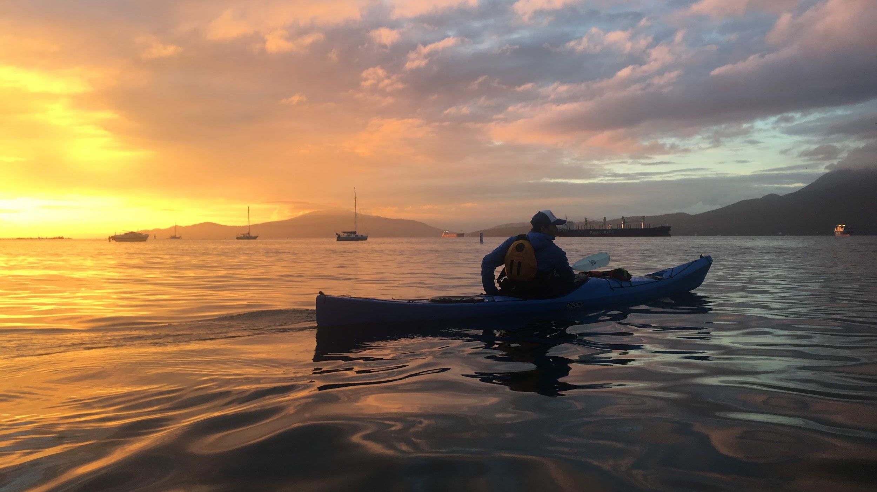
Notes:
We are all very fortunate to be in a city that is surrounded by water. There are an incredible number of water activities that we can enjoy right here in false creek, and there is a strong community of water users that paddle and boat throughout the area. These waters should continue to be celebrated and utilised by individuals that are connected to their waters, but these waters are also threatened by bacterial contamination that can severely impact the health of recreational water users looking to wade, paddle, and boat in False Creek. With beach closures across Metro Vancouver due to bacterial contamination it is increasingly important to have access to open, ongoing water quality data. We at Fraser Riverkeeper work to connect people to their waters, collect water quality samples, share both water quality data and water literacy information, and engage individuals with further opportunities to protect their waters.
With the Creekside Park Extension, it is increasingly important to monitor our waters and compile ongoing long term data to build the case for a swimmable false creek!

Slide 6
Notes:
Who has ever gone to a beach and seen the sign on the left?
No swimming. This could mean that the water isn’t safe and you could get sick from swimming in it.
How about the centre? A boil water advisory means that contaminants have been detected in the water and you could get sick from drinking it.
And finally the right? A no fishing sign sometimes means that it’s illegal and unsustainable to fish there, but sometimes that rule has been made because the fish themselves could make you sick
Not so great, right? Now imagine the red line of each circle is removed. That would be a future where you CAN safely SWIM, DRINK, and FISH.

Slide 7
Notes:
This is our Swim Drink Fish logo which demonstrates what we are FOR at Fraser Riverkeeper and SDF.
We work for a swimmable, drinkable, fishable future for all.

Slide 8
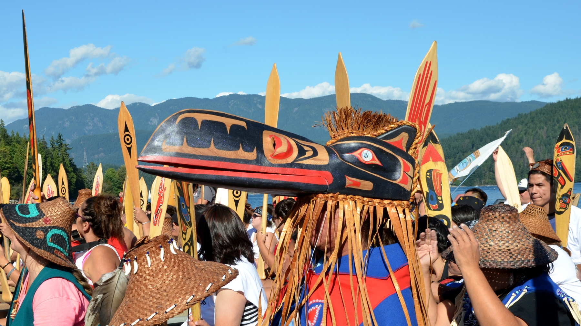
We acknowledge the land and water we work on is the traditional, ancestral and unceded territories of the Tsleil-Waututh (sel̓íl̓witulh), Squamish (sḵwx̱wú7mesh), and Musqueam (xʷməθkʷəy̓əm) First Nations.
Photo: Vancouver Media Co-op
Notes:
Our water is incredibly important to the peoples and cultures of this region. We acknowledge that we are on the land of the traditional, ancestral, and unceded territories of the Tsleil-Watuth, Squamish, and Musqueam First Nations. Since time immemorial, First Nations have been stewards of this land and water.

Slide 9
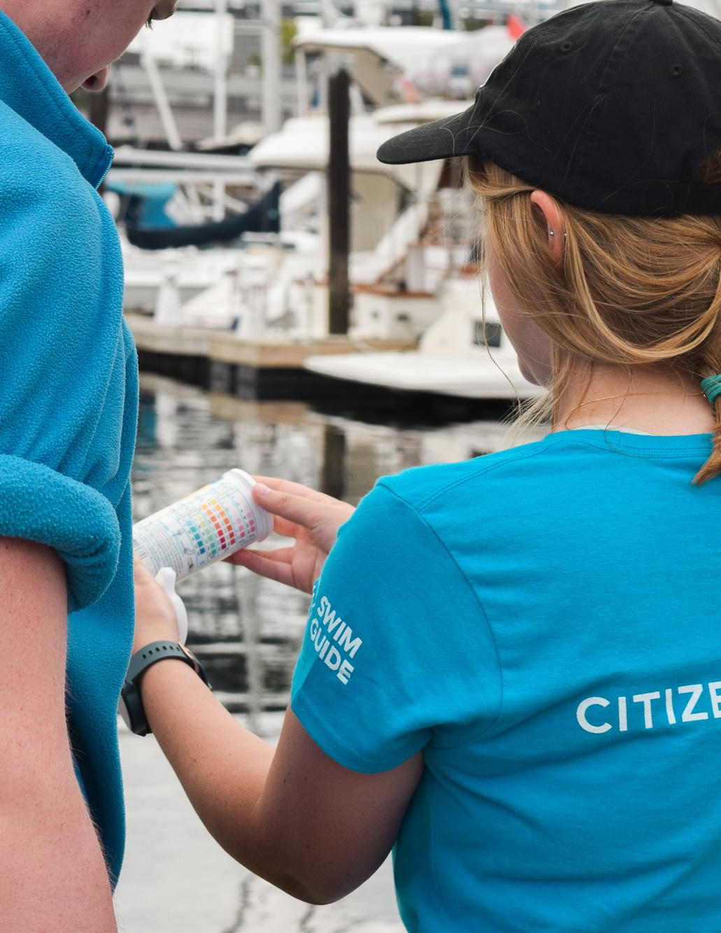
Vancouver Water Monitoring Program
Recreational water quality (ie. E.coli)
Three locations in False Creek
Citizen science-led
Collect, Share, Connect
Notes:
The Vancouver Water Monitoring Program, a citizen science initiative by Fraser Riverkeeper and Swim Drink Fish Canada, launched in July 2018 on Granville Island. In an effort to learn more about the recreational water quality in False Creek, Fraser Riverkeeper is the only group that samples year round.
The primary purpose of the program is the protection of public health from contaminated water. The goal of the program is to provide the public with current, reliable water quality data and prevent the spread of waterborne illnesses by making it easy for people to know when their water is contaminated and when it is clean for swimming.
Fraser Riverkeeper focuses on sampling well-used recreational hotspots around False Creek where stand up paddlers have been seen falling into the water, dogs and children wade at the shallows, kayakers are drenched by splashing water, and adventurous individuals plunge in to cool off. These sites are vulnerable to pollution, so we need to compile more data about how pollution threatens the health of our waterways. And additionally, these sites are very important to the community!
This program is citizen science-led because it is a concrete way to connect people to their waters. This connection is the foundation to engage people with behaviours that protect their water. Overall our program is focused on collecting water samples, sharing water quality results, and connecting more people to their waters, shaping engaged individuals working to protect their waters.
Now I’ll pass things over to Kate.

Slide 10
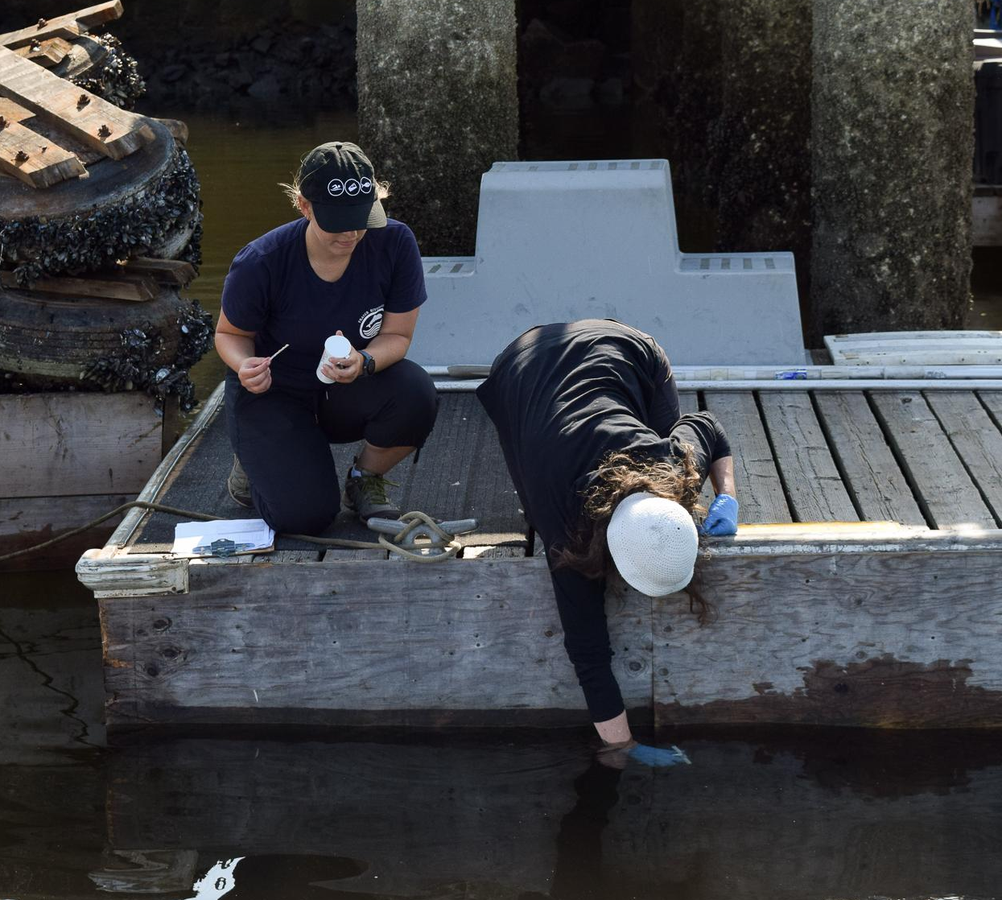
102 volunteers
390 donated hours
460 water samples
7 Engagement Days
>2,000 Clicks on Swim Guide
Notes:
Samples are collected around False Creek along with water quality parameters, such as salinity, turbidity, dissolved solids, etc., as well as environmental observations including recreational water users, weather, tides, wildlife, and any floating garbage.
Here’s a sneak peek at our statistics: we have had 102 volunteers donate 390 hours collecting 460 water samples. Last year, we had 7 engagement days monitoring with corporate and water recreation groups. The beaches that we sampled were viewed over 2,000 times on our app and website Swim Guide that we’ll introduce shortly.

Slide 11
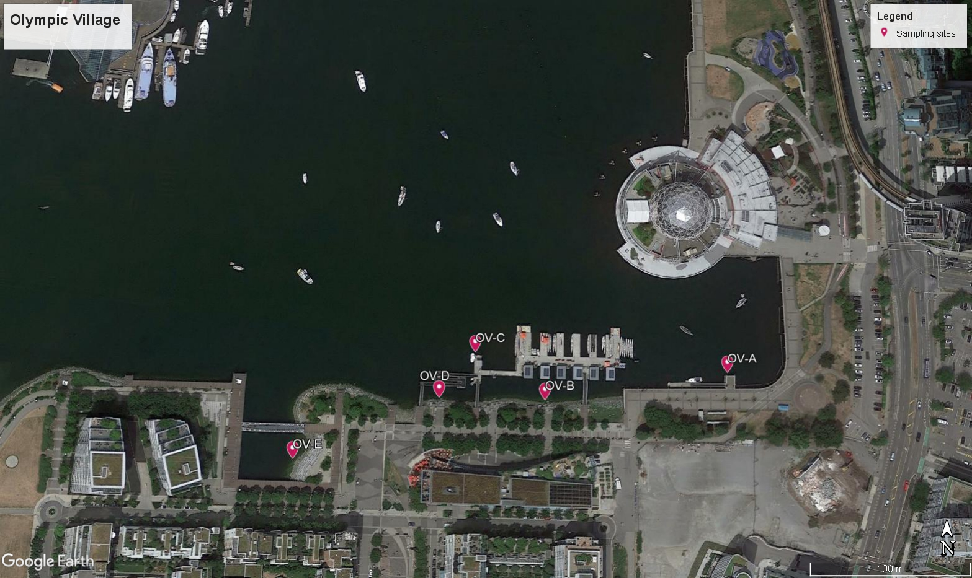
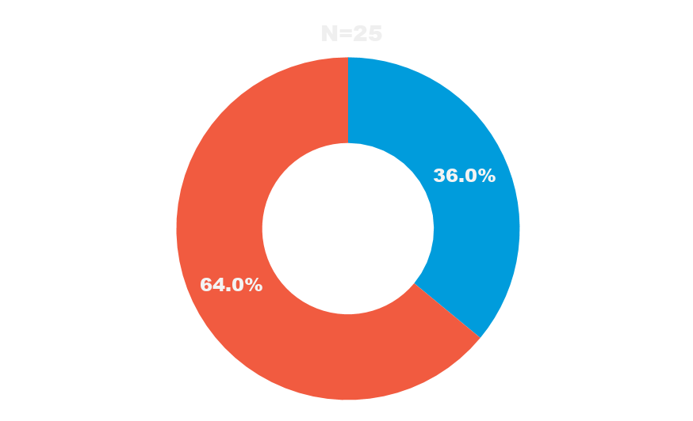
Fail
Pass
Notes:
We sample 5 locations at three sites along False Creek.
Here you can see the 5 places where we collect water quality samples at the Olympic Village site, just adjacent to where we are now!

Slide 12
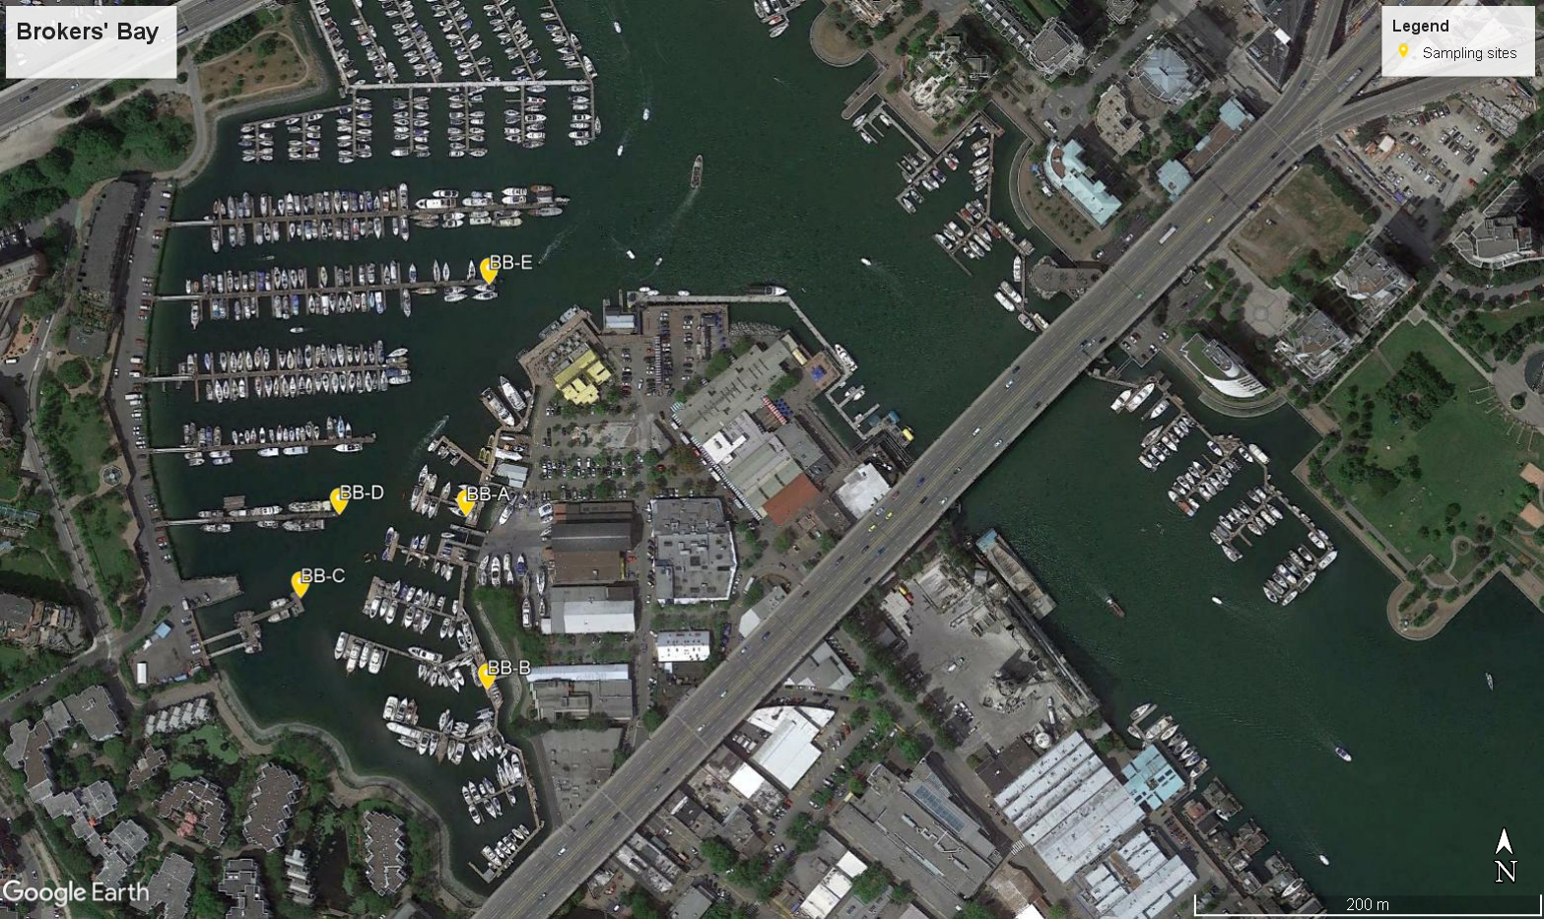
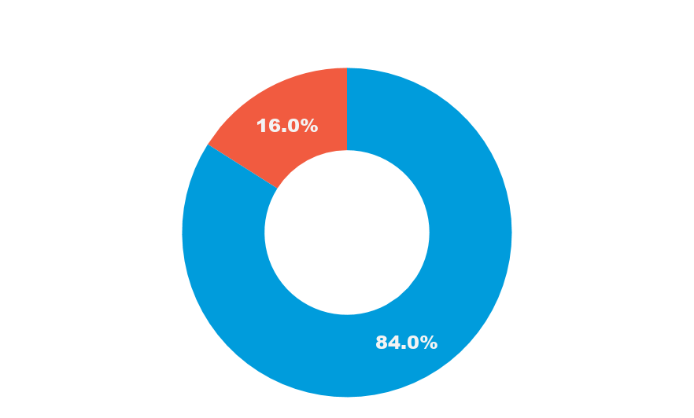
Fail
Pass
Notes:
We cycle from Olympic Village to Granville Island, our second site.
The pentagon is where our microbiology lab is located.

Slide 13
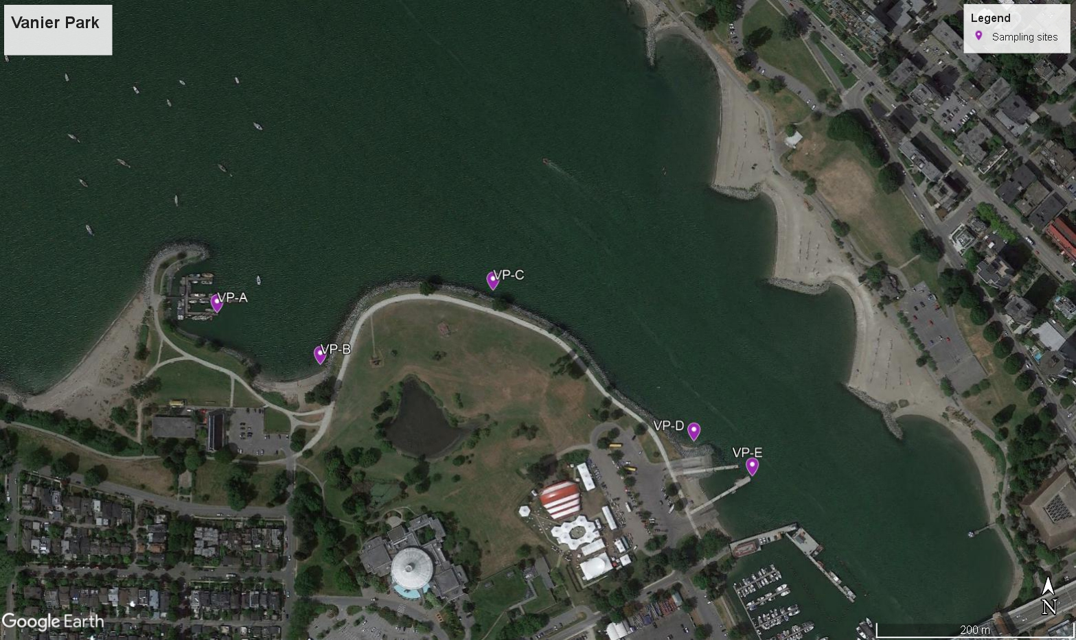
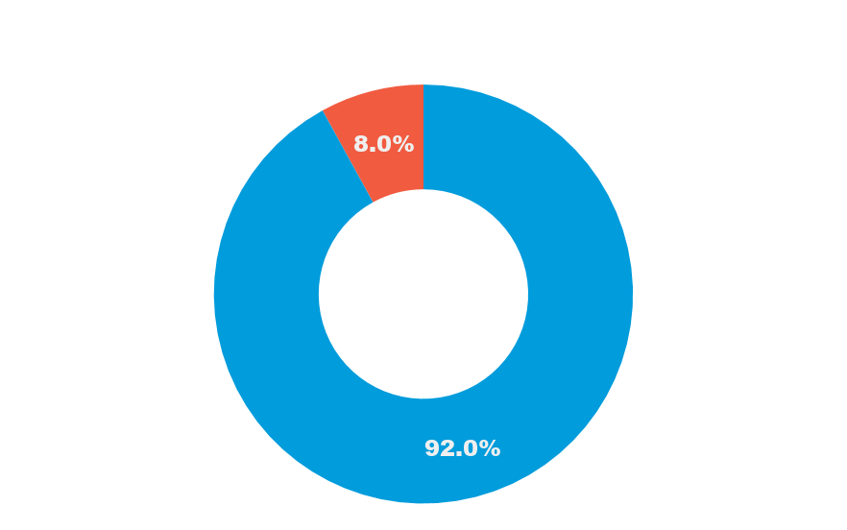
Fail
Pass
Notes:
Our third location is Vanier Park

Slide 14
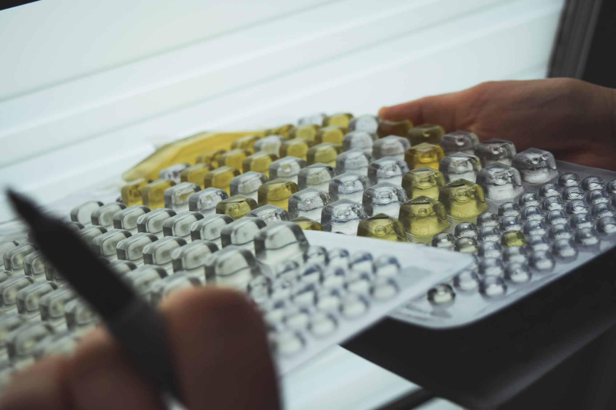
Notes:
Then the samples are brought to Fraser Riverkeeper’s in-house, microbiological IDEXX lab on Granville Island and analysed using a Colilert system for testing E. coli levels in water. As E. coli is an indicator of sewage, the more E. coli present in a sample the greater risk to public health and the environment. We are the only group that samples year round, our results serve to supplement the weekly samples taken by Vancouver Coastal Health from three locations in False Creek: Olympic Village, Brokers Bay, and Vanier Park.
All new sites have been added to Swim Guide, a free app and website, where the sampling results will be published weekly.

Slide 15
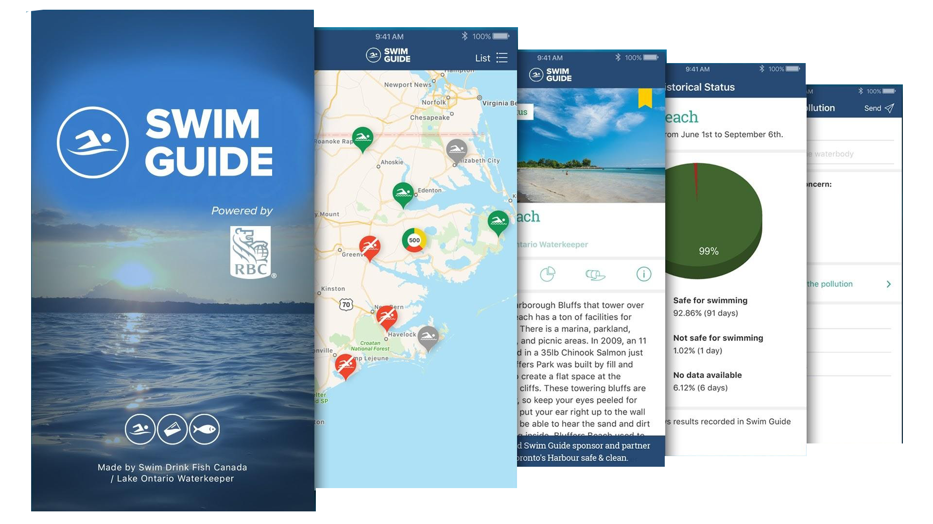
Notes:
We share the results from our water samples as well as those collected by Metro Vancouver with the public on Swim Guide. In 2019 we reached 4 million Swim Guide users, making it the most widely used app for recreational water quality in the world. Swim Guide helps you easily find your closest beaches, know at a glance which ones are safe for swimming, report pollution, and share your love of beaches with friends and family.

Slide 16
Notes:
So this is a beach listing from not too far away. Has anyone been here before?
So you can see that Vanier Park has passed water quality tests 60-95% of the time, and if you scrolled down you could see the individual tests and when they were taken. One of the best things about Swim Guide is that it gets its water quality updates from both government and non-governmental organizations – there are over 70 affiliates.

Slide 17
Report pollution
Notes:
If you want to contribute to our movement and help to keep our waters clean you can easily report pollution. If you ever see water that looks polluted, take a picture of it and upload it on Swim Guide. Pollution reports are geotagged with descriptions which help us investigate it, send the information to the right sources, and figure out how to clean it up!

Slide 18
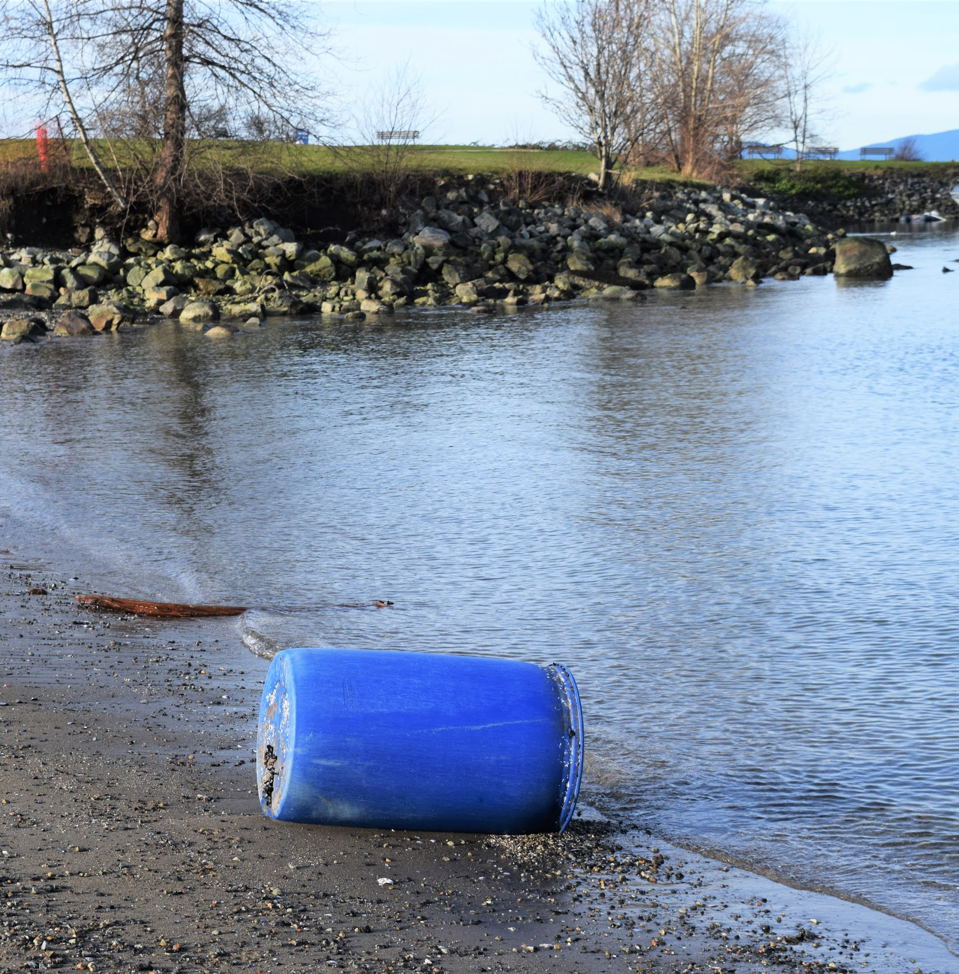
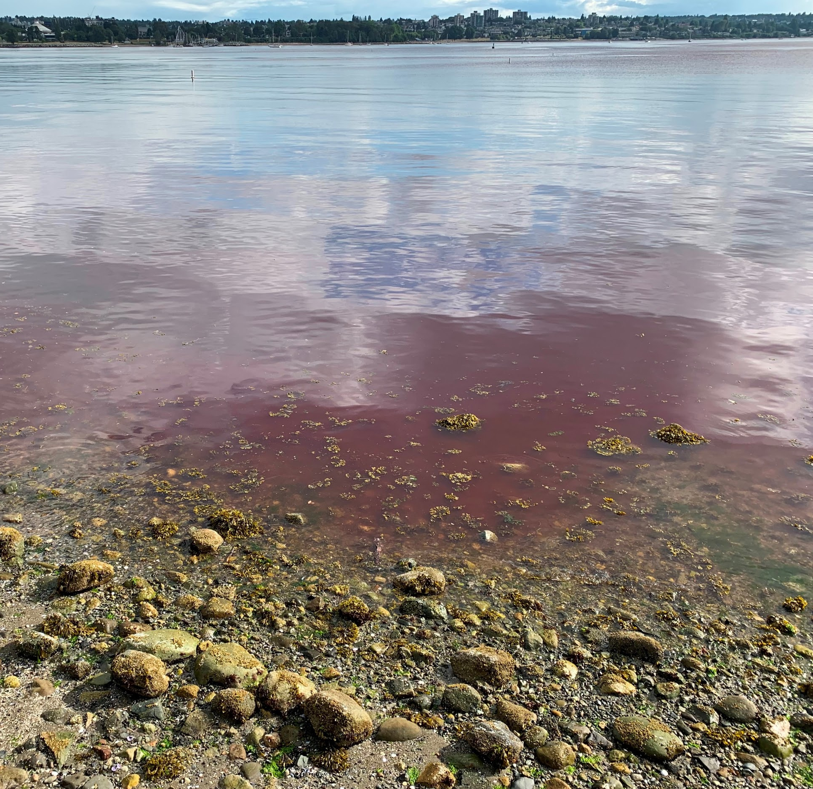
Notes:
Here are some examples of pollution that you might report!
This past summer, someone submitted the photo on the right to us through Swim Guide. They were concerned that there was Red Tide in Burrard inlet. We were able to contact the health authorities and learned that the red colour in the water was a non-toxic bacteria that only affected clams or shellfish.

Slide 19
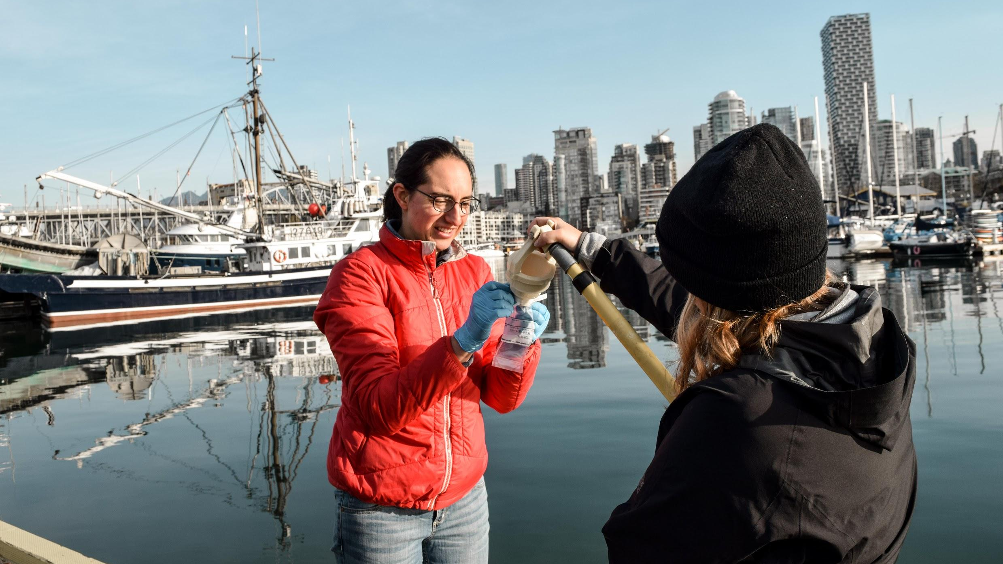
Volunteer as a citizen scientist
Notes:
Another way you can contribute to the Swim Drink Fish movement is by volunteering as a citizen scientist. We are always looking for volunteers to join Kate, our Water Monitoring Coordinator, on Thursday mornings to collect our water samples in False Creek. You can sign up on our website fraserriverkeeper.ca or chat with us afterwards to get the details. Jacqui and Mick joined us on a particularly rainy day back in January, and with your support we are hoping to set up a monitoring location on the North Eastern shore of False Creek!

Slide 20
Notes:
If you are interested in learning more about our monitoring program, please join us on Friday February 28th at the Creekside Community Center. We will be sharing some of our results from 2019, the first-ever year-round monitoring program on False Creek.
If you want more information about the event please stop by our table!

Slide 21
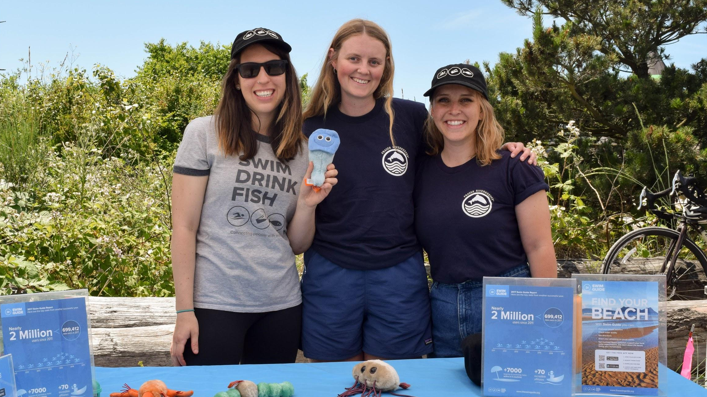
Thank you.
Follow us @FraserRivkeeper
www.fraserriverkeeper.ca

